Slide 1
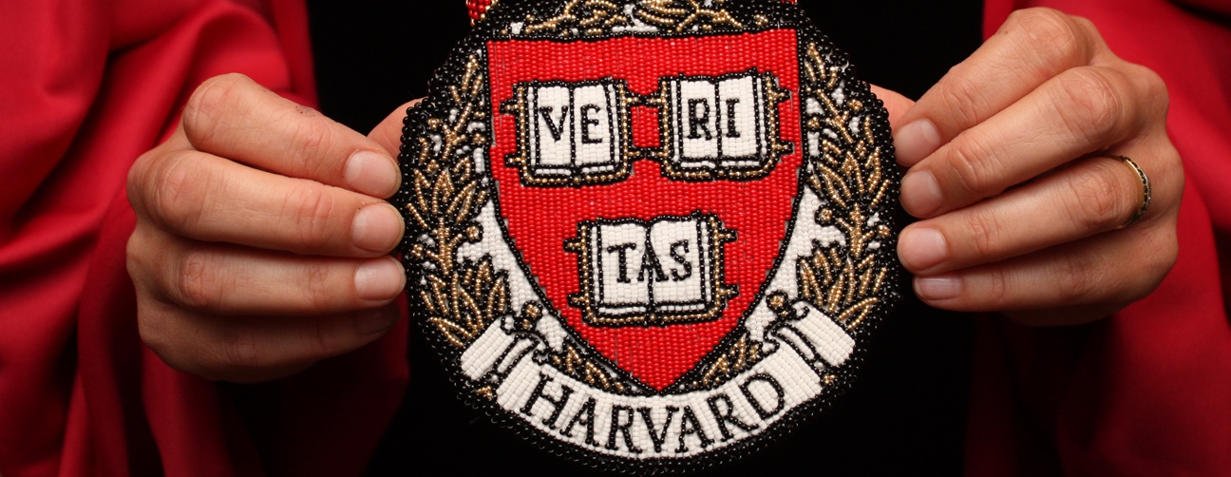
HARVARD UNIVERSITY NATIVE AMERICAN PROGRAM
WHAT IS HUNAP
WHO IS HUNAP
HUNAP RESOURCES

Slide 2

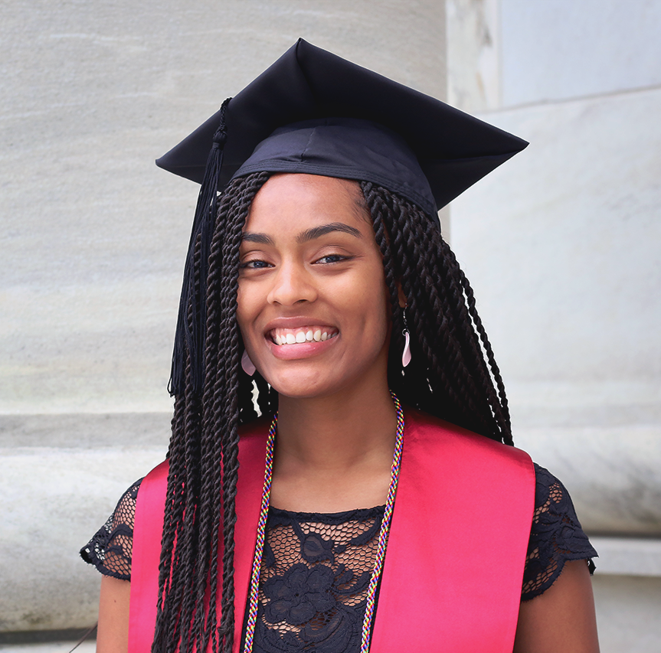
What is HUNAP
HUNAP promotes Native and Indigenous academic scholarship AND seeks to build a thriving Indigenous student community
We do this in four ways:
  Academic Programs
  Partnerships
  Recruitment/Admissions
  Student Support

Slide 3
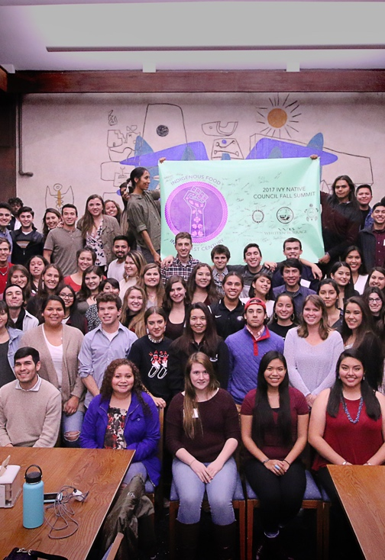
Who is HUNAP
HUNAP is
  STUDENTS/SCHOLARS
  STAFF
  FACULTY ADVISORY BOARD

Slide 4
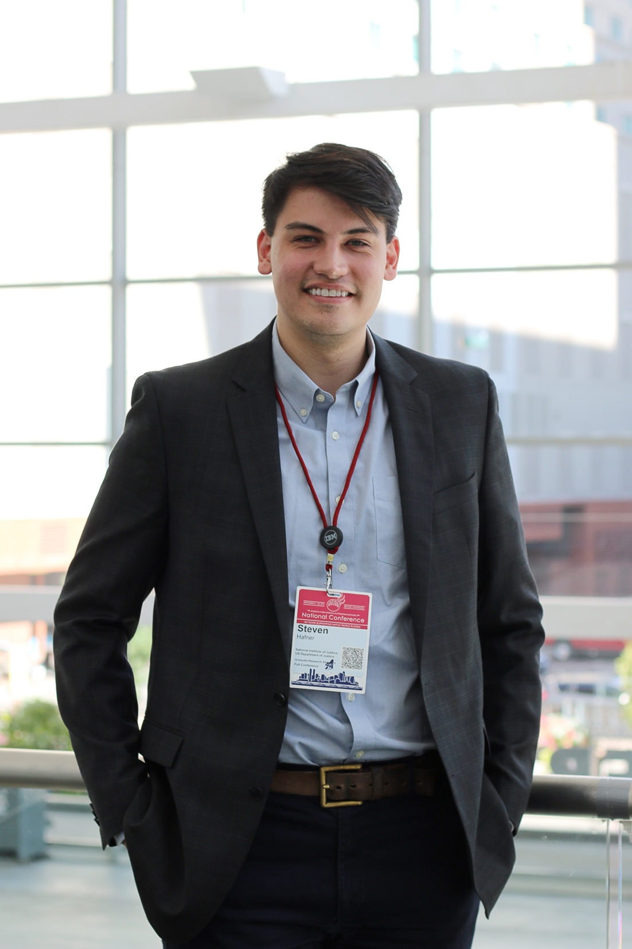
Academic Programs
Indigenous Health Seminar
HUNAP Annual Lecture Series
Harvard Native American & Indigenous Studies Working Group
Faculty Guest Speaker Grants

Slide 5

Partnerships
Harvard Project on American Indian Economic Development
Oneida Nation Visiting Professor of Law (HLS)
Harvard Peabody Museum
David Rockefeller Center for Latin American Studies
Tozzer Library
Four Directions Summer Research Program
Radcliffe Institute
SEAS REU program
Office for Fine Arts
and more...

Slide 6
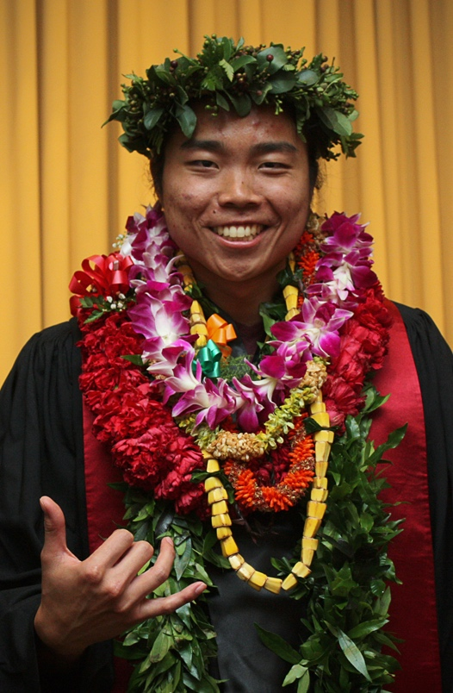
Recruitment & Admissions
HUNAP actively recruits prospective students and, when possible, in partnership with all thirteen admissions offices on campus
Recruitment Travel
Admissions Counseling
On-Campus Recruitment Programs
Admissions Liaison
*HUNAP students are welcome to seek admissions counseling from Jason

Slide 7
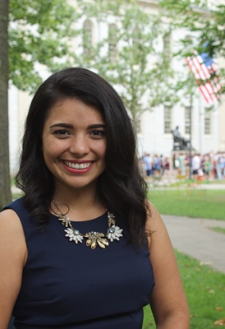
Student Support
There are 103 Native/Indigenous students in the HUNAP community
Academic
Research/Library support
Language Instruction
Research Grants
Career/Professional Development
Alumni Networking
Local + Summer Opportunities
Letters of Recommendation
Conference Grants

Slide 8
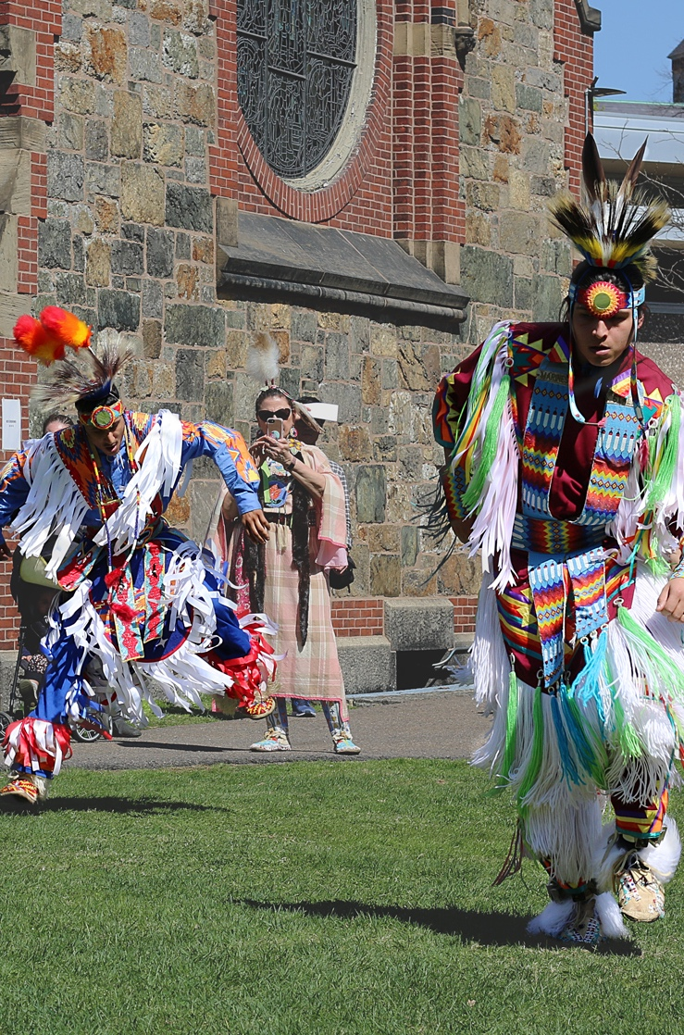
Student Support
Advocacy
  Individually
  Student Organizations
  Administratively
    If you are engaging the university and seek assistance, HUNAP is here
Individual Support
Study Breaks
Social Programming
Potlucks
Career Advisement
HUNAP Office,
14 Story St 4th Floor
Events (e.g., Harvard Powwow)
Just ask…

Slide 9
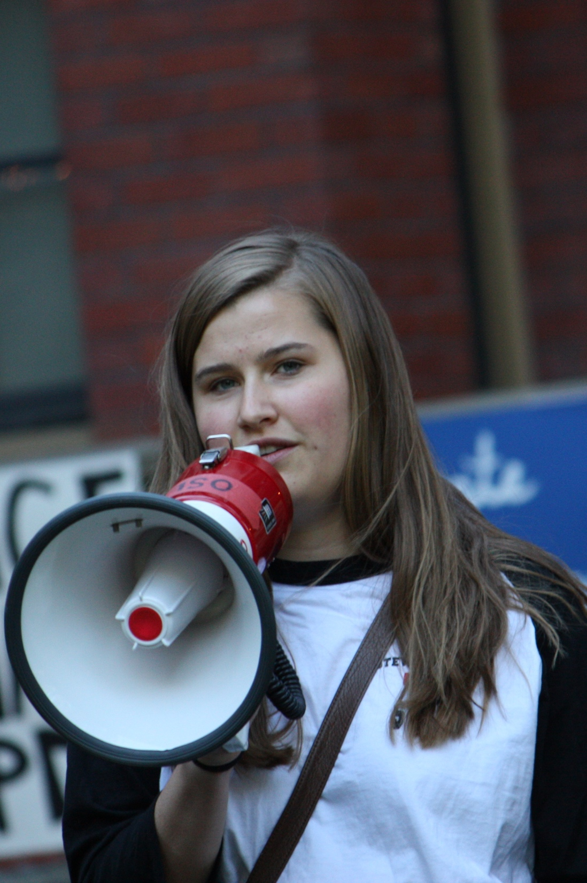
Student Organizations
Harvard College
Natives at Harvard College
Graduate/Professional Schools
Harvard Indigenous Design Collective (GSD)
Future Indigenous Educators Resisting Colonial Education (HGSE)
Harvard Native American Law Student Association (HLS)
Harvard Native Health Organization (HMS)
Harvard Native American Student Organization (TH Chan)
Campus
Harvard Indigenous Women’s Group

Slide 10
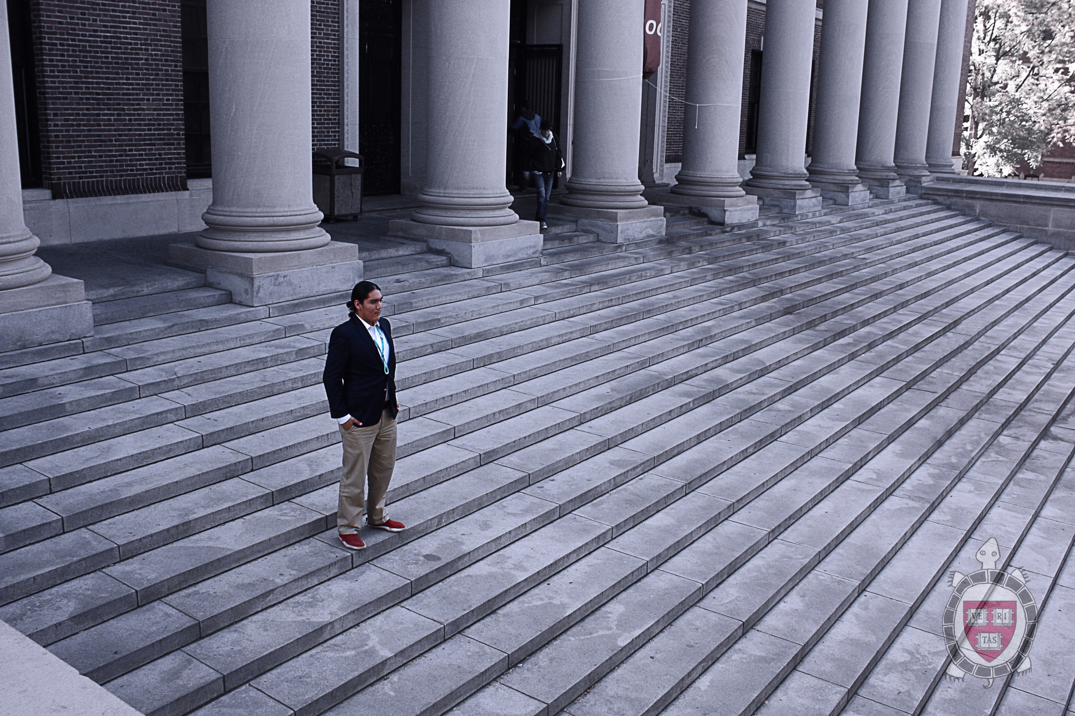
Stay Connected
Weekly Emails
Jason_Packineau@Harvard.edu
617-5997460 Text/Call

